Slide 1
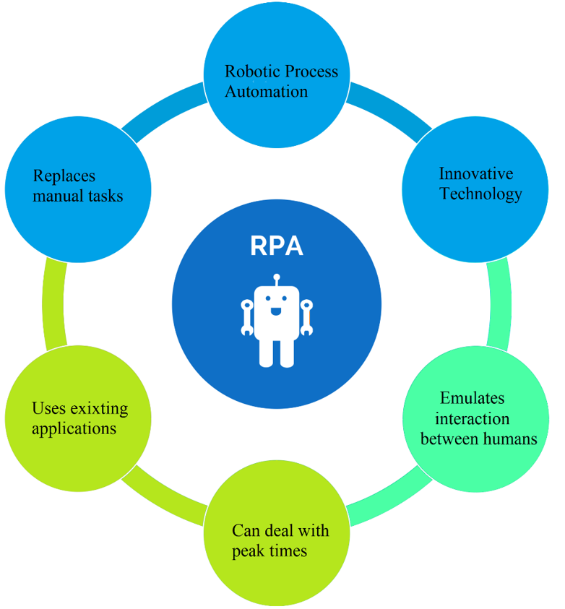
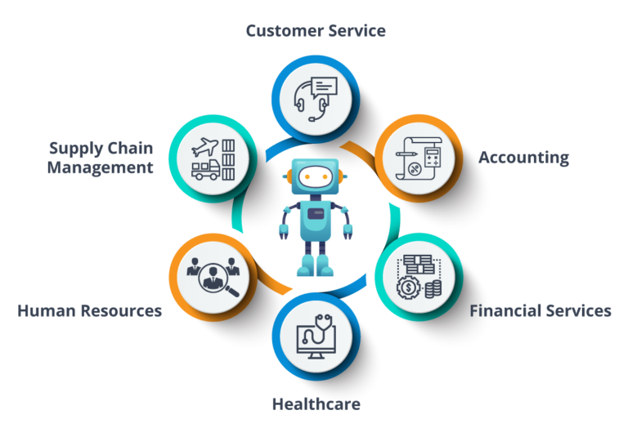
ROBOTIC PROCESS AUTOMATION

Slide 2
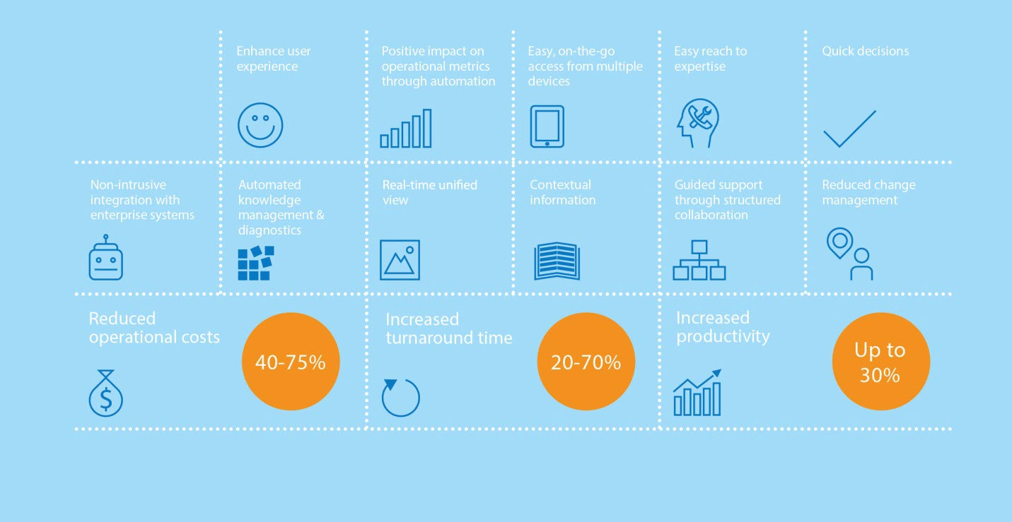
The RPA Benefits

Slide 3
RPA PDF Extraction Bot
Organizations in the Construction domain need to extract and post the Operation and Maintenance Manual data. Manually extracting and posting the data for thousands of process is a hectic and time consuming process.
Difficulties:
Operators have to manually extract the data from PDFs
They need to post the extracted data in excel sheet manually for thousand of process
Human efforts and more processing time is needed for huge data which results in less ROI
Solution:
RPA PDF Extraction Bot tries to automate the process of extracting the PDF data and post the extracted data to a word document. The bot then creates a reference object of the word document in the excel sheet. The automation can help the organizations in reducing the overall data extraction and posting time which in turn make the process smooth, fast and increases the productivity and ROI

Slide 4
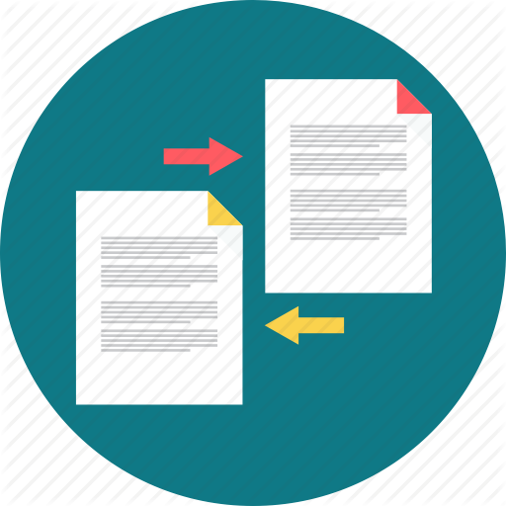


RPA PDF Extraction Bot

Slide 5
Conclusion
RPA PDF Extraction Bot can be useful for Organization in the Construction domain and help them out in extracting and posting thousands of data. The bot can be integrated with multiple other systems as well for reporting purpose.

Slide 6


